Slide 1
Goal scoring in the AFL: A linear modelling exploration
Trent Henderson | 20 May 2021

Slide 2
Agenda
Premise of and motivation for the current analysis
Available data and reputability of sources
Analytical approach and appropriateness of linear modelling assumptions
Results and implications for AFL teams
Limitations and recommendations for future analysis

Slide 3
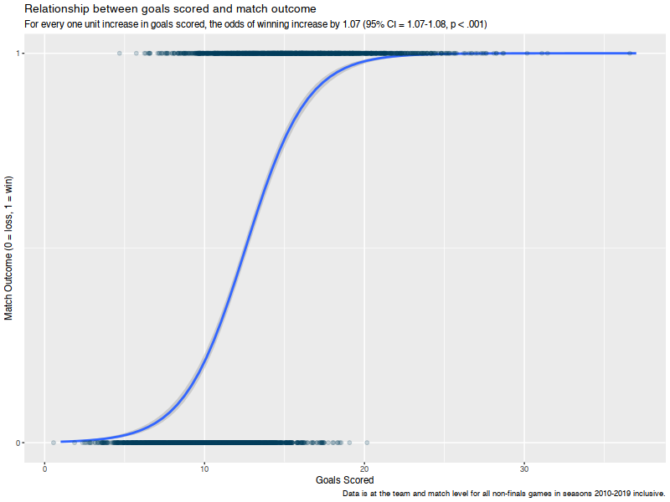
Scoring goals is critical to winning AFL games – can linear modelling help to understand what is associated with it?
In AFL, teams can score points by either kicking a goal (6 points) or a behind (1 point)
It is intuitive that kicking more goals should lead to a higher likelihood of winning the game
But simply getting a team to kick more goals is not feasible
Can we quantitatively explore what other aspects of gameplay are associated with goal scoring?

Slide 4
A large amount of historical data is available and previous open-source work has linked multiple reputable sources
Data Sources
Variables

Slide 5
A robust and detailed linear modelling approach was used
Data extraction from API
Data cleaning, aggregation and sense checks
Exploratory data analysis and visualisation
Linear model fitting
Final model outputs, comparative analysis, and data visualisation
Assumption checking

Slide 6
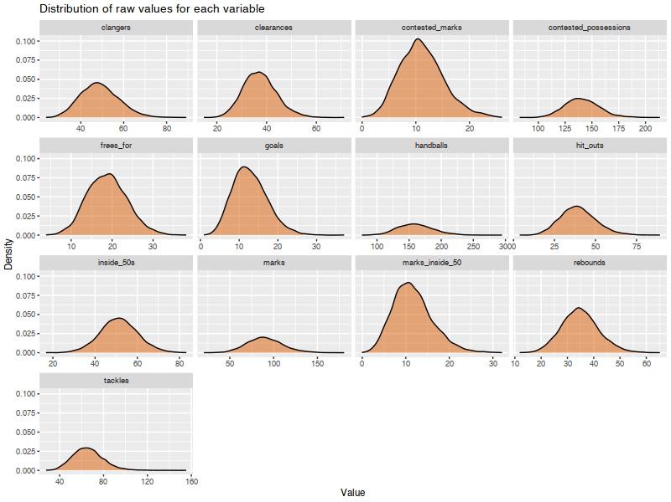
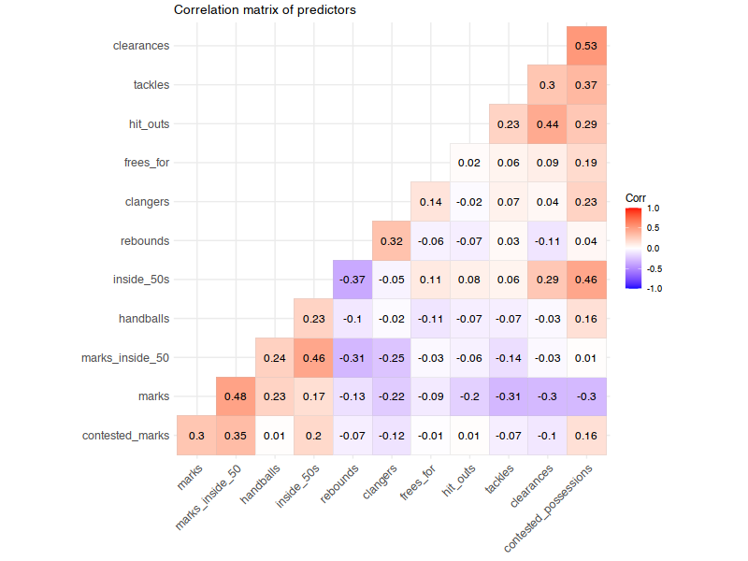
Core linear modelling assumptions were rigorously tested

Slide 7
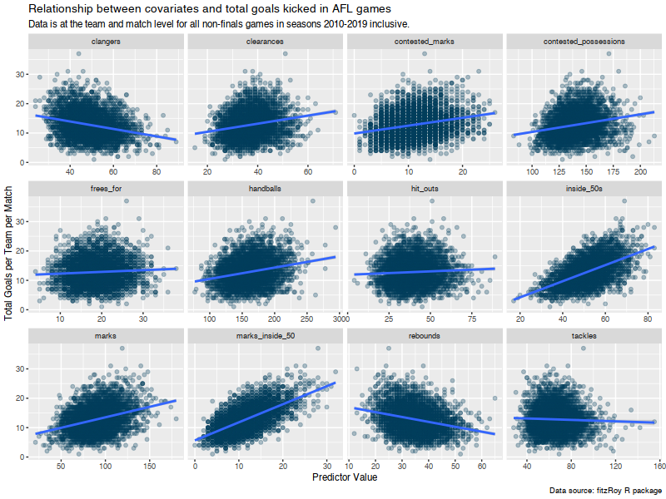
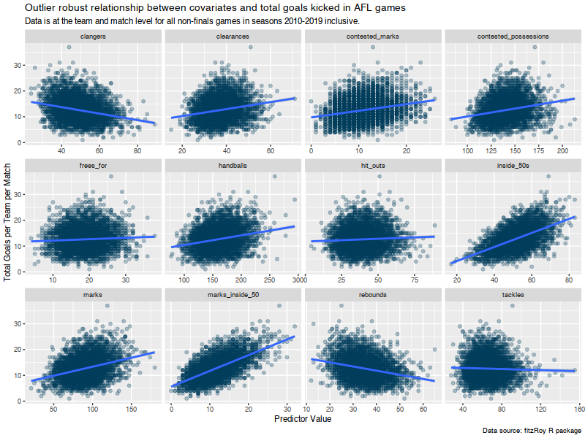
Core linear modelling assumptions were rigorously tested

Slide 8
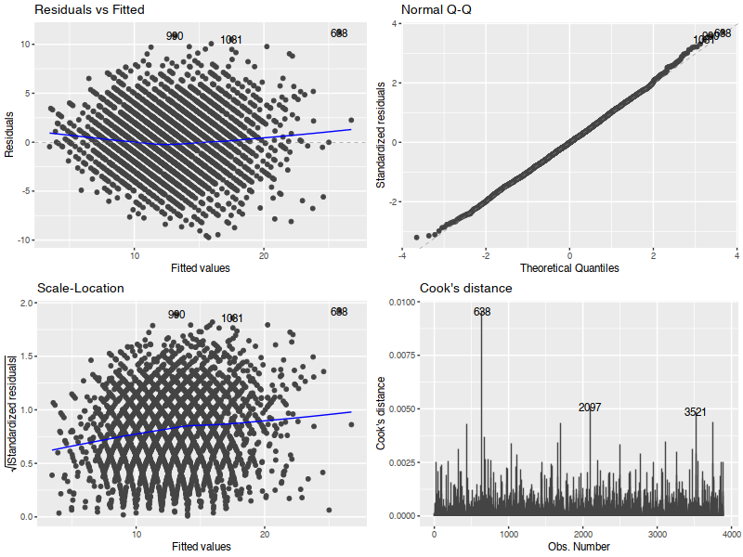
Core linear modelling assumptions were rigorously tested

Slide 9
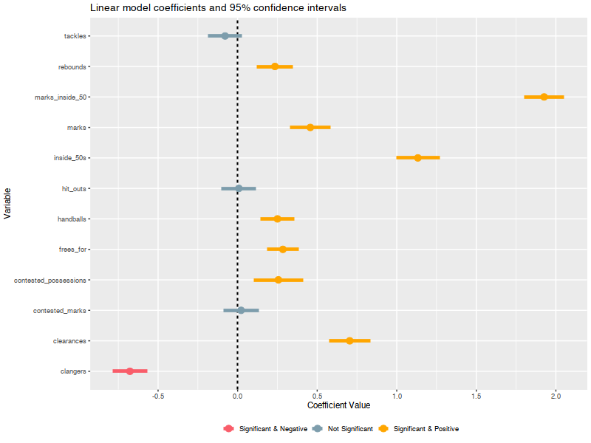
A selection of core gameplay metrics were able to predict the number of goals scored by individual teams in games
Tackles and hit outs did not meaningfully predict goals scored
This is intuitive, as they are not core gameplay features that may indicate offensive football
Clangers (unforced errors) was the only negative predictor
The positive coefficient of clearances is surprising given its defensive attribution
The strong positive coefficient for marks inside 50 makes sense given that these lead to controlled “set shot” attempts at goal

Slide 10
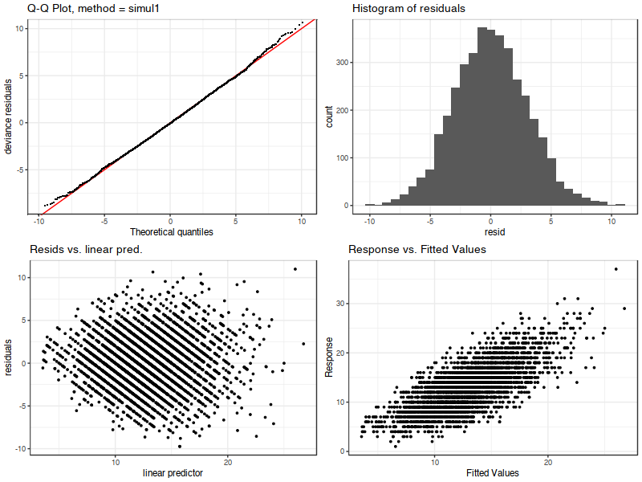
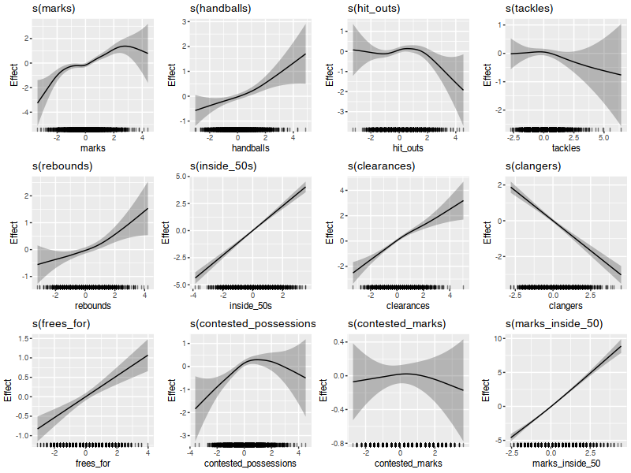
The analysis was taken a step further through the specification of generalised additive models

Slide 11
A number of limitations and potential methods to address them have been identified
Not all variables in the available datasets were explored
The datasets contained a very large number of variables, a shortlist of which were used for this analysis due to prior hypotheses
Future research should examine all variables, potentially using Lasso Regression
Small deviations in residuals were noted, but addition of quadratic terms did not fix it
A minor sag was noted in the residuals plot, suggesting use of a polynomial term
It remains unclear whether an ordinary least squares regression approach is optimal
A GAM follow-up analysis yielded slightly superior model fit at a lower AIC
There may be differential relationships for each team or for home and away teams
Exploring these interactions may reveal unique team-level gameplay differences or a quantification of the “home team advantage”

Slide 12


Questions?

